Slide 1
Traffic Accident Severity Prediction
Sushant Sakhalkar

Slide 2
Data
DataSet is received from Kaggle
Redundant Data was dropped
30+ Features are Selected and presented

Slide 3
TARGET
0 :- Low Severity
1 :- High Severity

Slide 4
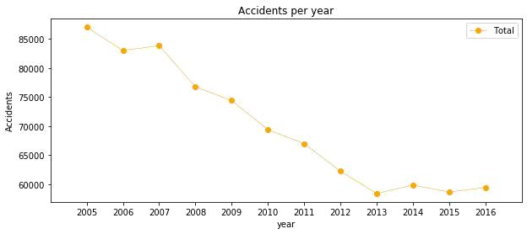
The Accidents are decreasing over the years from 2005 - 2013

Slide 5
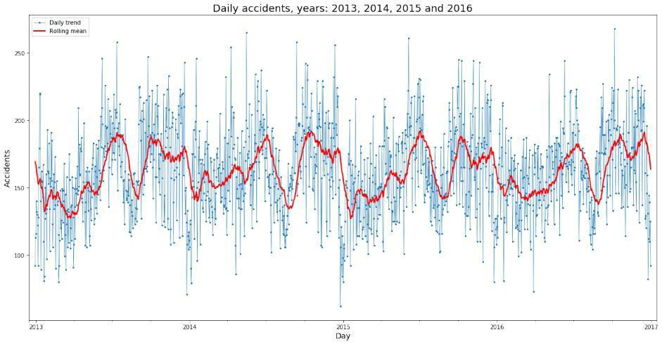
Trends in Daily Accidents

Slide 6
Different Types of Model Classification
Random Forest:
Logistic Regression
K-Nearest Neighbor
Supervised Vector Machine

Slide 7
Results
The metrics used to compare the accuracy of the models are the Jaccard
Score, f1-score, Precision and Recall. This table reports the results of the evaluation of each model.
Algorithm |  | Jaccard | f1-score | Precision | Recall | Time(s)
Random Forest |  | 0.722 | 0.72 | 0.724 | 0.591 | 6.588
Logistic Regression |  | 0.661 | 0.65 | 0.667 | 0.456 | 6.530
KNN |  | 0.664 | 0.66 | 0.652 | 0.506 | 200.58
SVM |  | 0.659 | 0.65 | 0.630 | 0.528 | 403.92

Slide 8
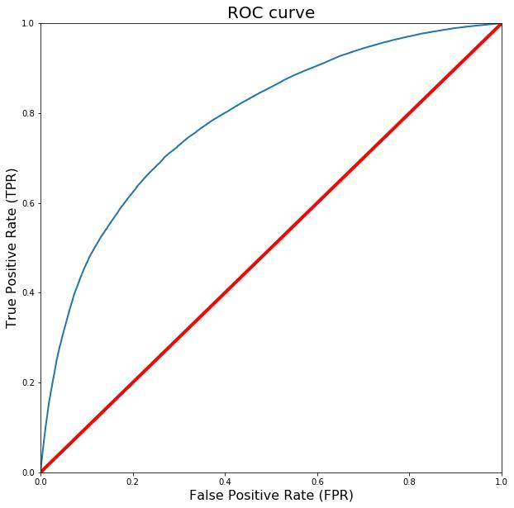

Slide 9
Conclusion
These models can have multiple application in real life. For instance, imagine that emergency services have a application with some default features such as date, time and department/municipality and then with the information given by the witness calling to inform on the accident they could predict the severity of the accident before getting there and so alert nearby hospitals and prepare with the necessary equipment and stats

